Slide 1
Fluvial Geomorphology: Longitudinal profile and cross sections
Zach HIlgendorf

Slide 2
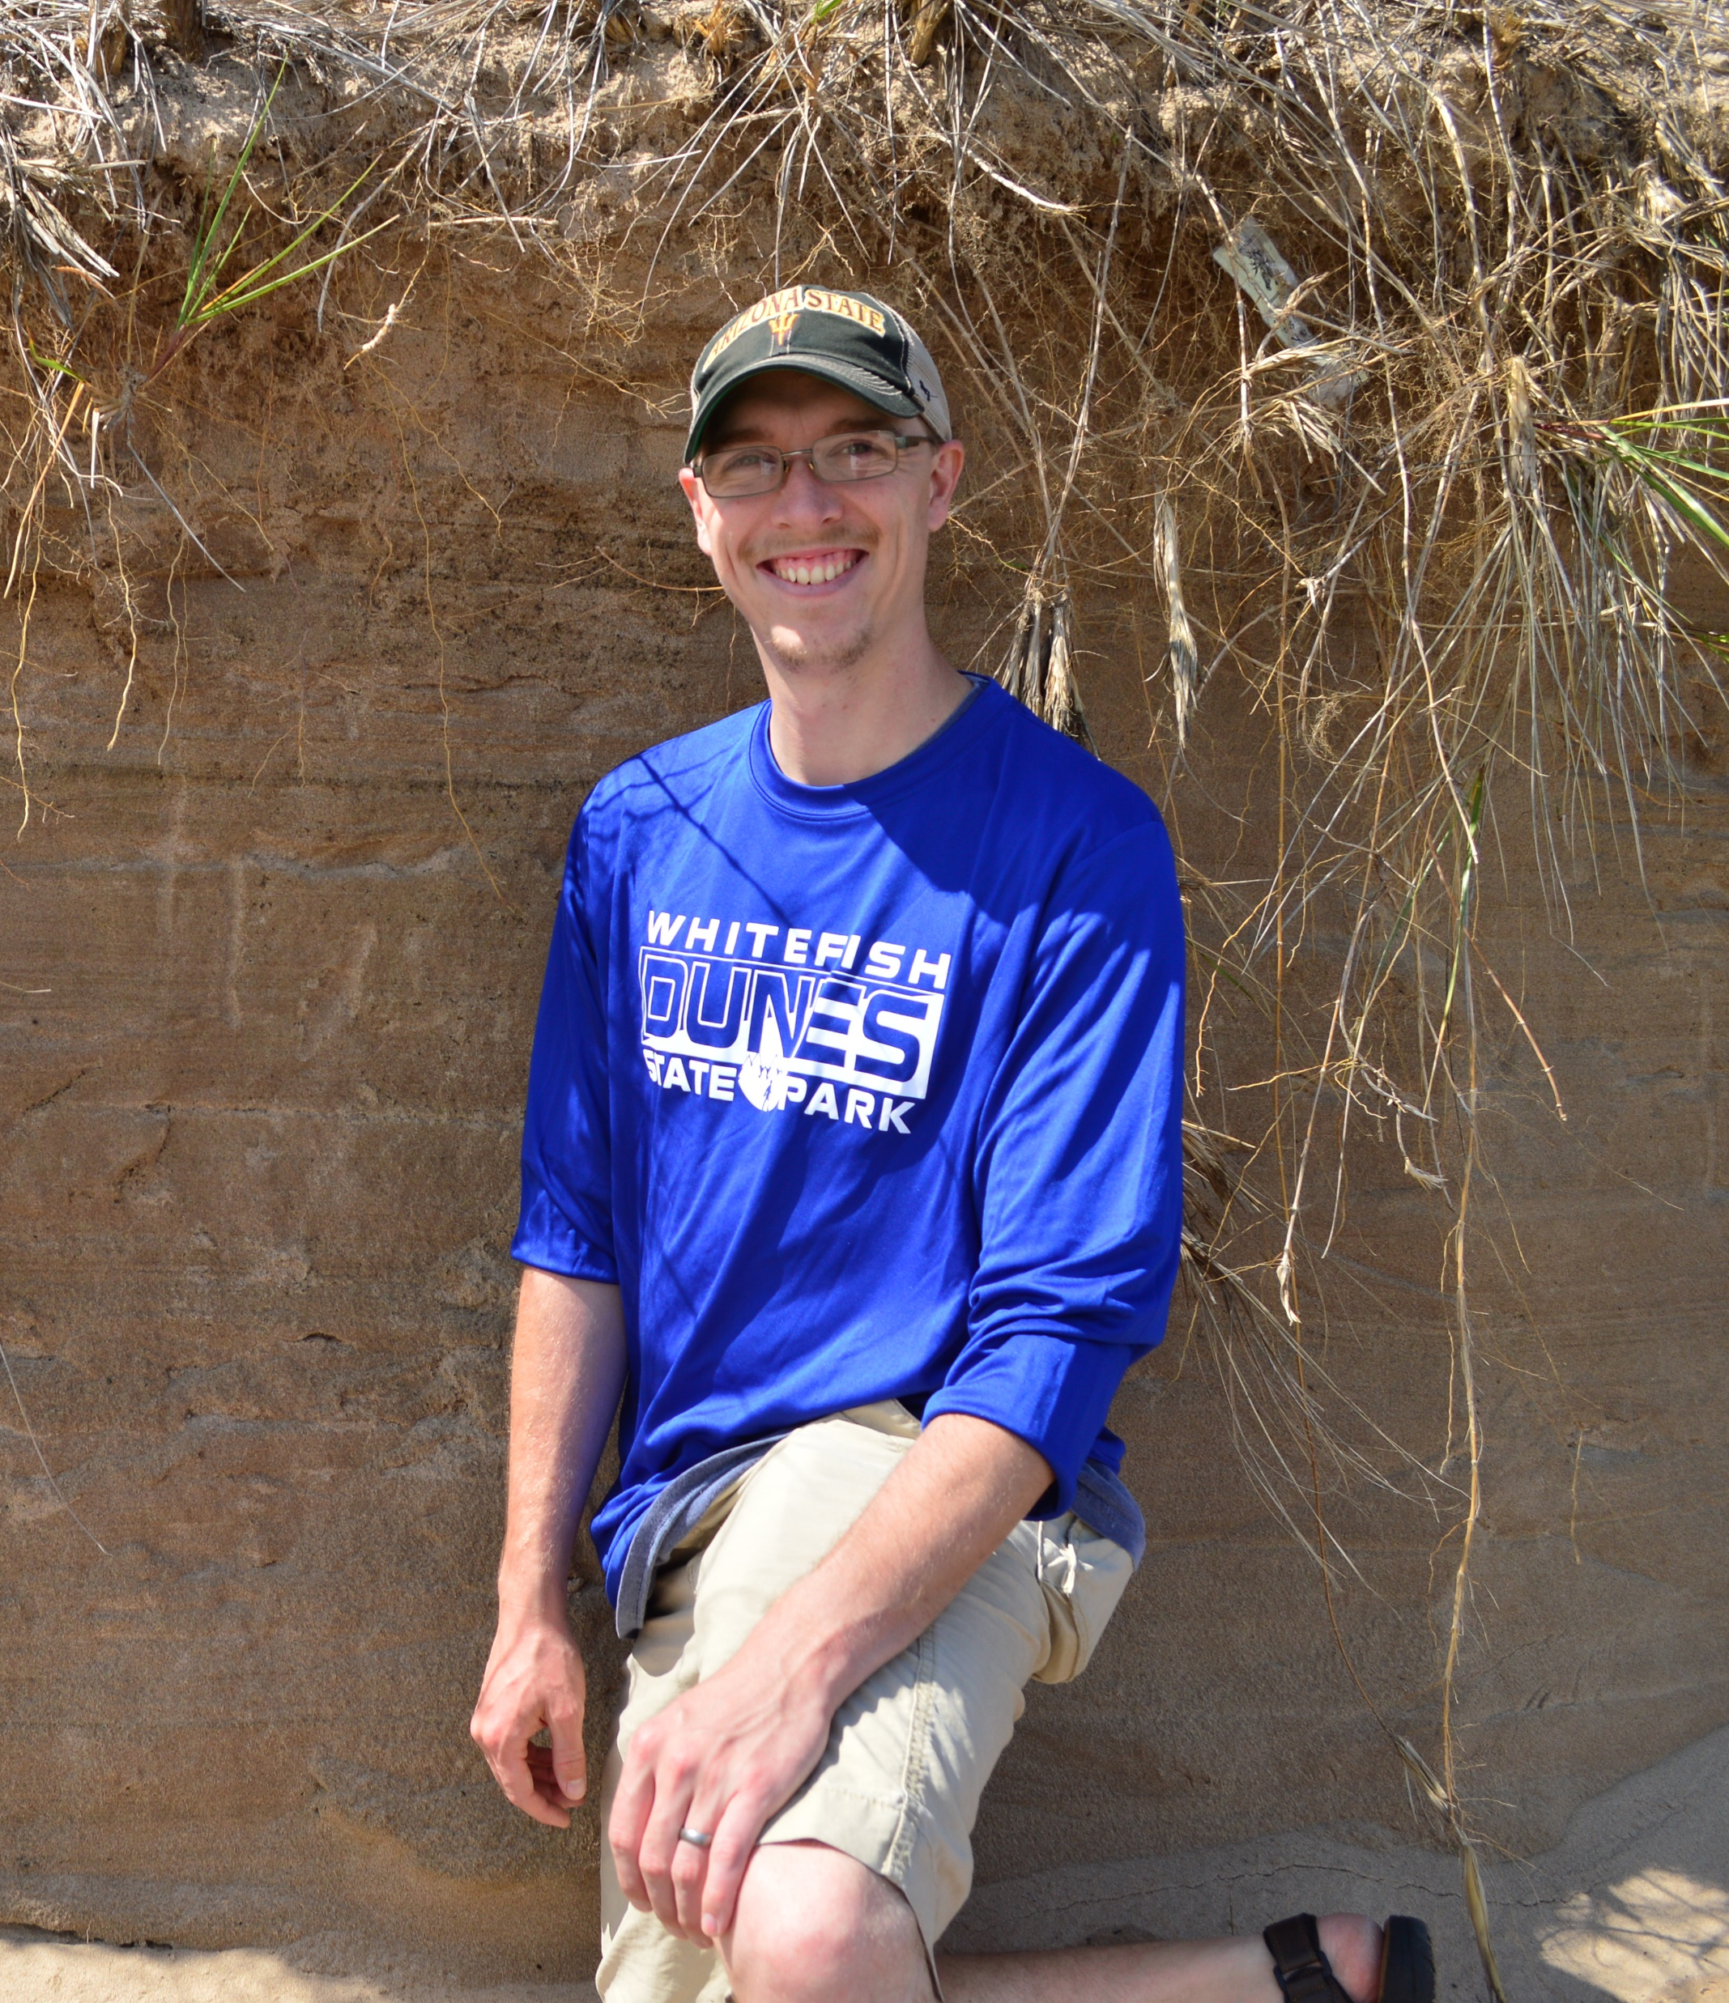
Objectives
Understanding slope, grain, activity, and shape relationships related to the longitudinal (long) profile.
The geo-nerd currently talking…

Slide 3
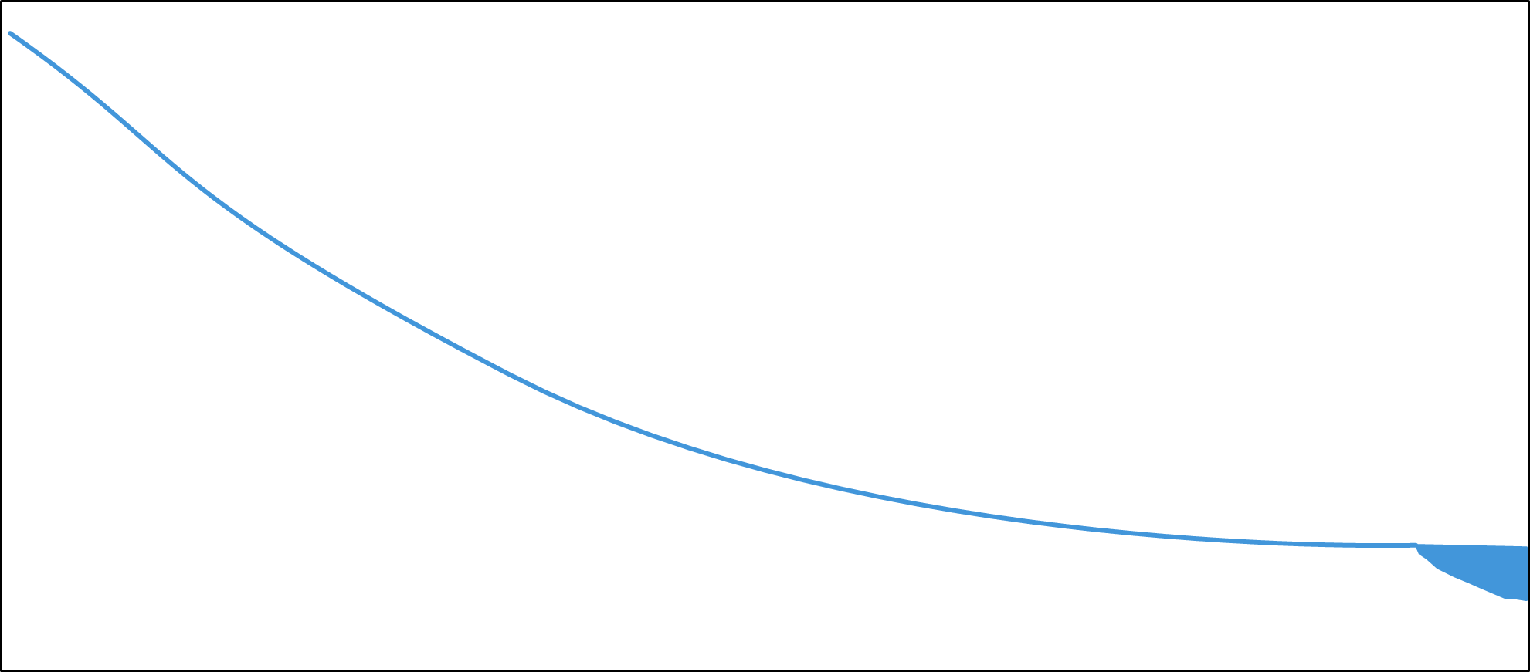
What is the Long Profile?
Two-Dimensional Profile of the Stream
Slope of water
Measured through the center of the channel from mouth to headwaters
Characteristically Concave Up Shape

Slide 4
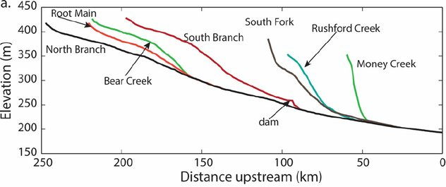
What is the Long Profile?
Two-Dimensional Profile of the Stream
Slope of water
Measured through the center of the channel from mouth to headwaters
Characteristically Concave Up Shape
Never That Simple!
Stout et al. (2014)

Slide 5
What is the Long Profile?
Two-Dimensional Profile of the Stream
Slope of water
Measured through the center of the channel from mouth to headwaters
Characteristically Concave Up Shape
Never That Simple!
Stout et al. (2014)

Slide 6
What is the Long Profile?
Two-Dimensional Profile of the Stream
Slope of water
Measured through the center of the channel from mouth to headwaters
Characteristically Concave Up Shape
Never That Simple!
Stout et al. (2014)

Slide 7
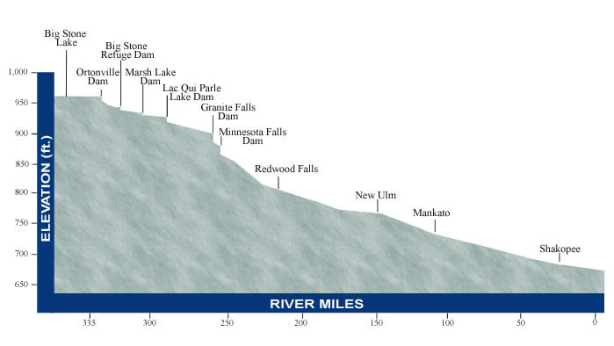
What is the Long Profile?
Two-Dimensional Profile of the Stream
Slope of water
Measured through the center of the channel from mouth to headwaters
Characteristically Concave Up Shape
Never That Simple!
Can be Controlled by:
Geology
Tectonics
Climate
Human Modifications
Minnesota River Basin Data Center (2003)

Slide 8
General Long profile trends

Slide 9
Longitudinal Profile
Slope
Boulders
Modified from Anderson and Anderson (2010)
Dominant
Transport
Dominant
Activity
Bed
Materials

Slide 10
Longitudinal Profile
Slope
Boulders
0.02
0.001
0.00001
Modified from Anderson and Anderson (2010)
Dominant
Transport
Dominant
Activity
Bed
Materials

Slide 11
Longitudinal Profile
Slope
Boulders
0.02
0.001
0.00001
Modified from Anderson and Anderson (2010)
Dominant
Transport
Dominant
Activity
Erosion
Bed
Materials
Erosion/Transport
Transport/Deposition
Deposition/Transport

Slide 12
Longitudinal Profile
Slope
Boulders
0.02
0.001
0.00001
Modified from Anderson and Anderson (2010)
Dominant
Transport
Bedload
Dominant
Activity
Bedload/Suspended
Bed
Materials
Suspension/Solution
Solution/Suspension
Boulders
Gravel
Sand
Silt and Clay
>256 mm
2-256 mm
0.06-2 mm
< 0.06 mm

Slide 13
Longitudinal Profile
Slope
Boulders
0.02
0.001
0.00001
Modified from Anderson and Anderson (2010)
Dominant
Transport
Bedload
Dominant
Activity
Bedload/Suspended
Erosion
Bed
Materials
Erosion/Transport
Suspension/Solution
Transport/Deposition
Solution/Suspension
Deposition/Transport
Boulders
Gravel
Sand
Silt and Clay
>256 mm
2-256 mm
0.06-2 mm
< 0.06 mm

Slide 14
Longitudinal Profile
Slope
Boulders
0.02
0.001
0.00001
Modified from Anderson and Anderson (2010)
Dominant
Transport
Bedload
Bedload/Suspended
Bed
Materials
Suspension/Solution
Solution/Suspension
Boulders
Gravel
Sand
Silt and Clay
>256 mm
2-256 mm
0.06-2 mm
< 0.06 mm

Slide 15
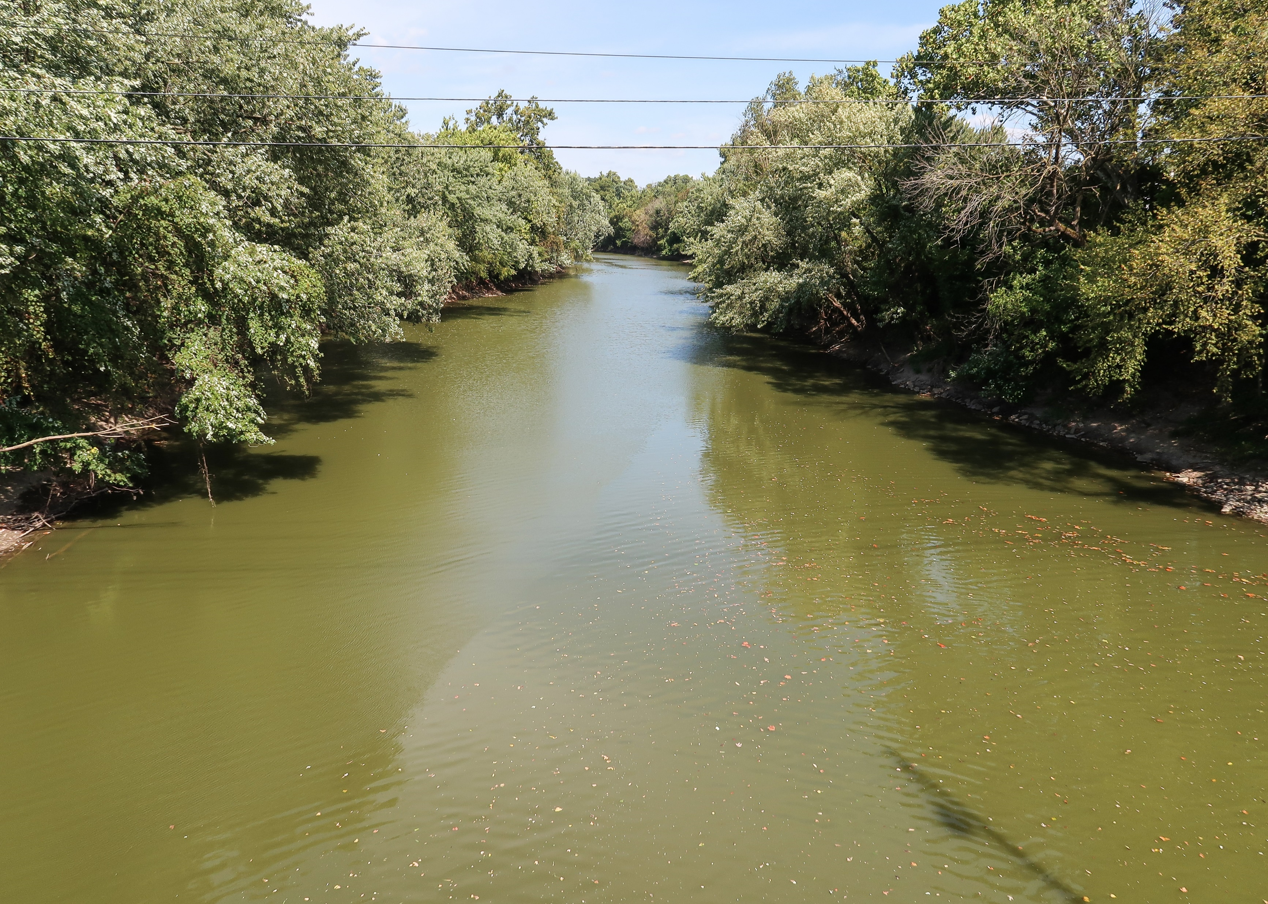
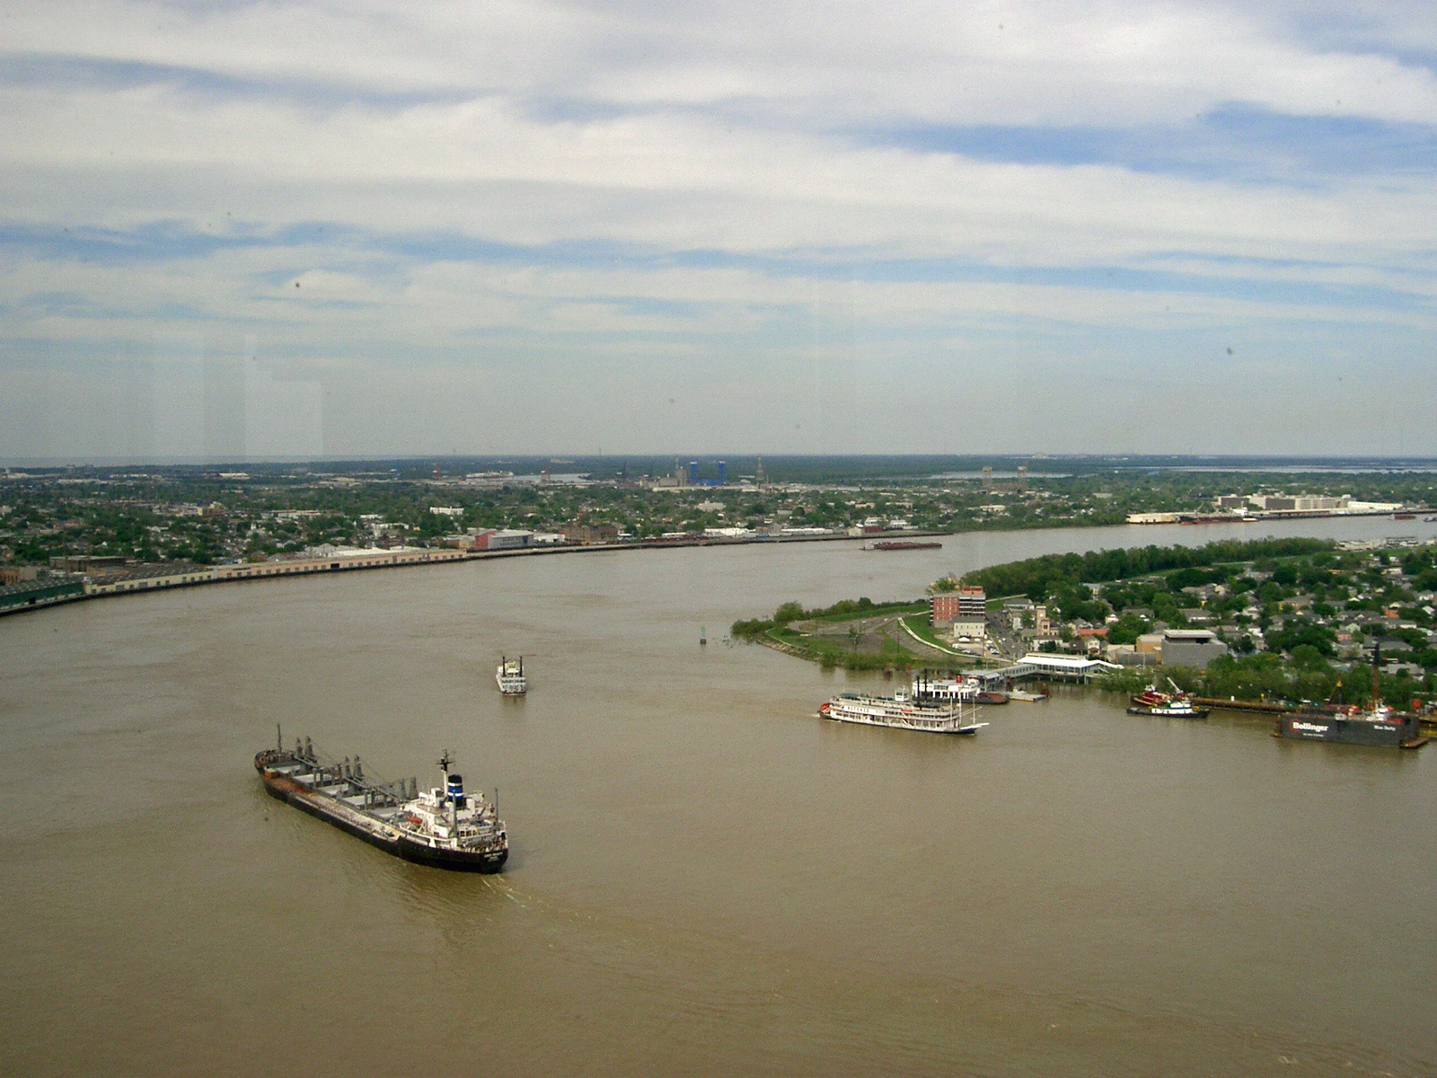
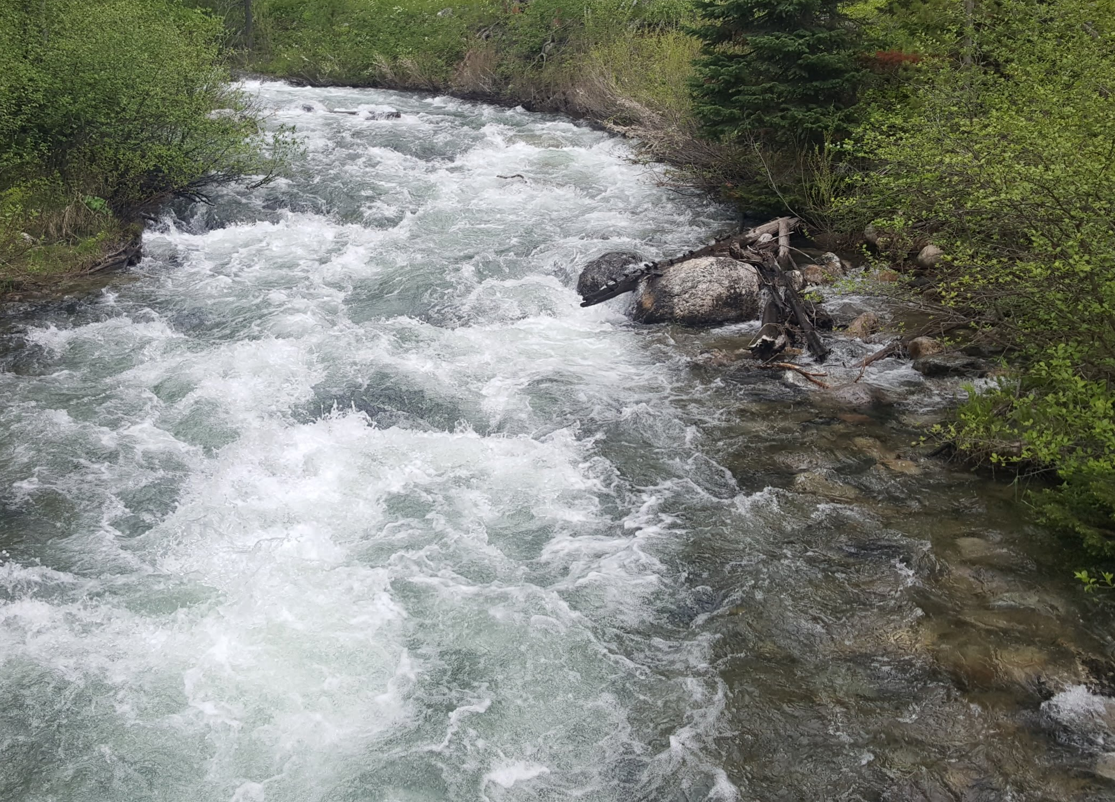
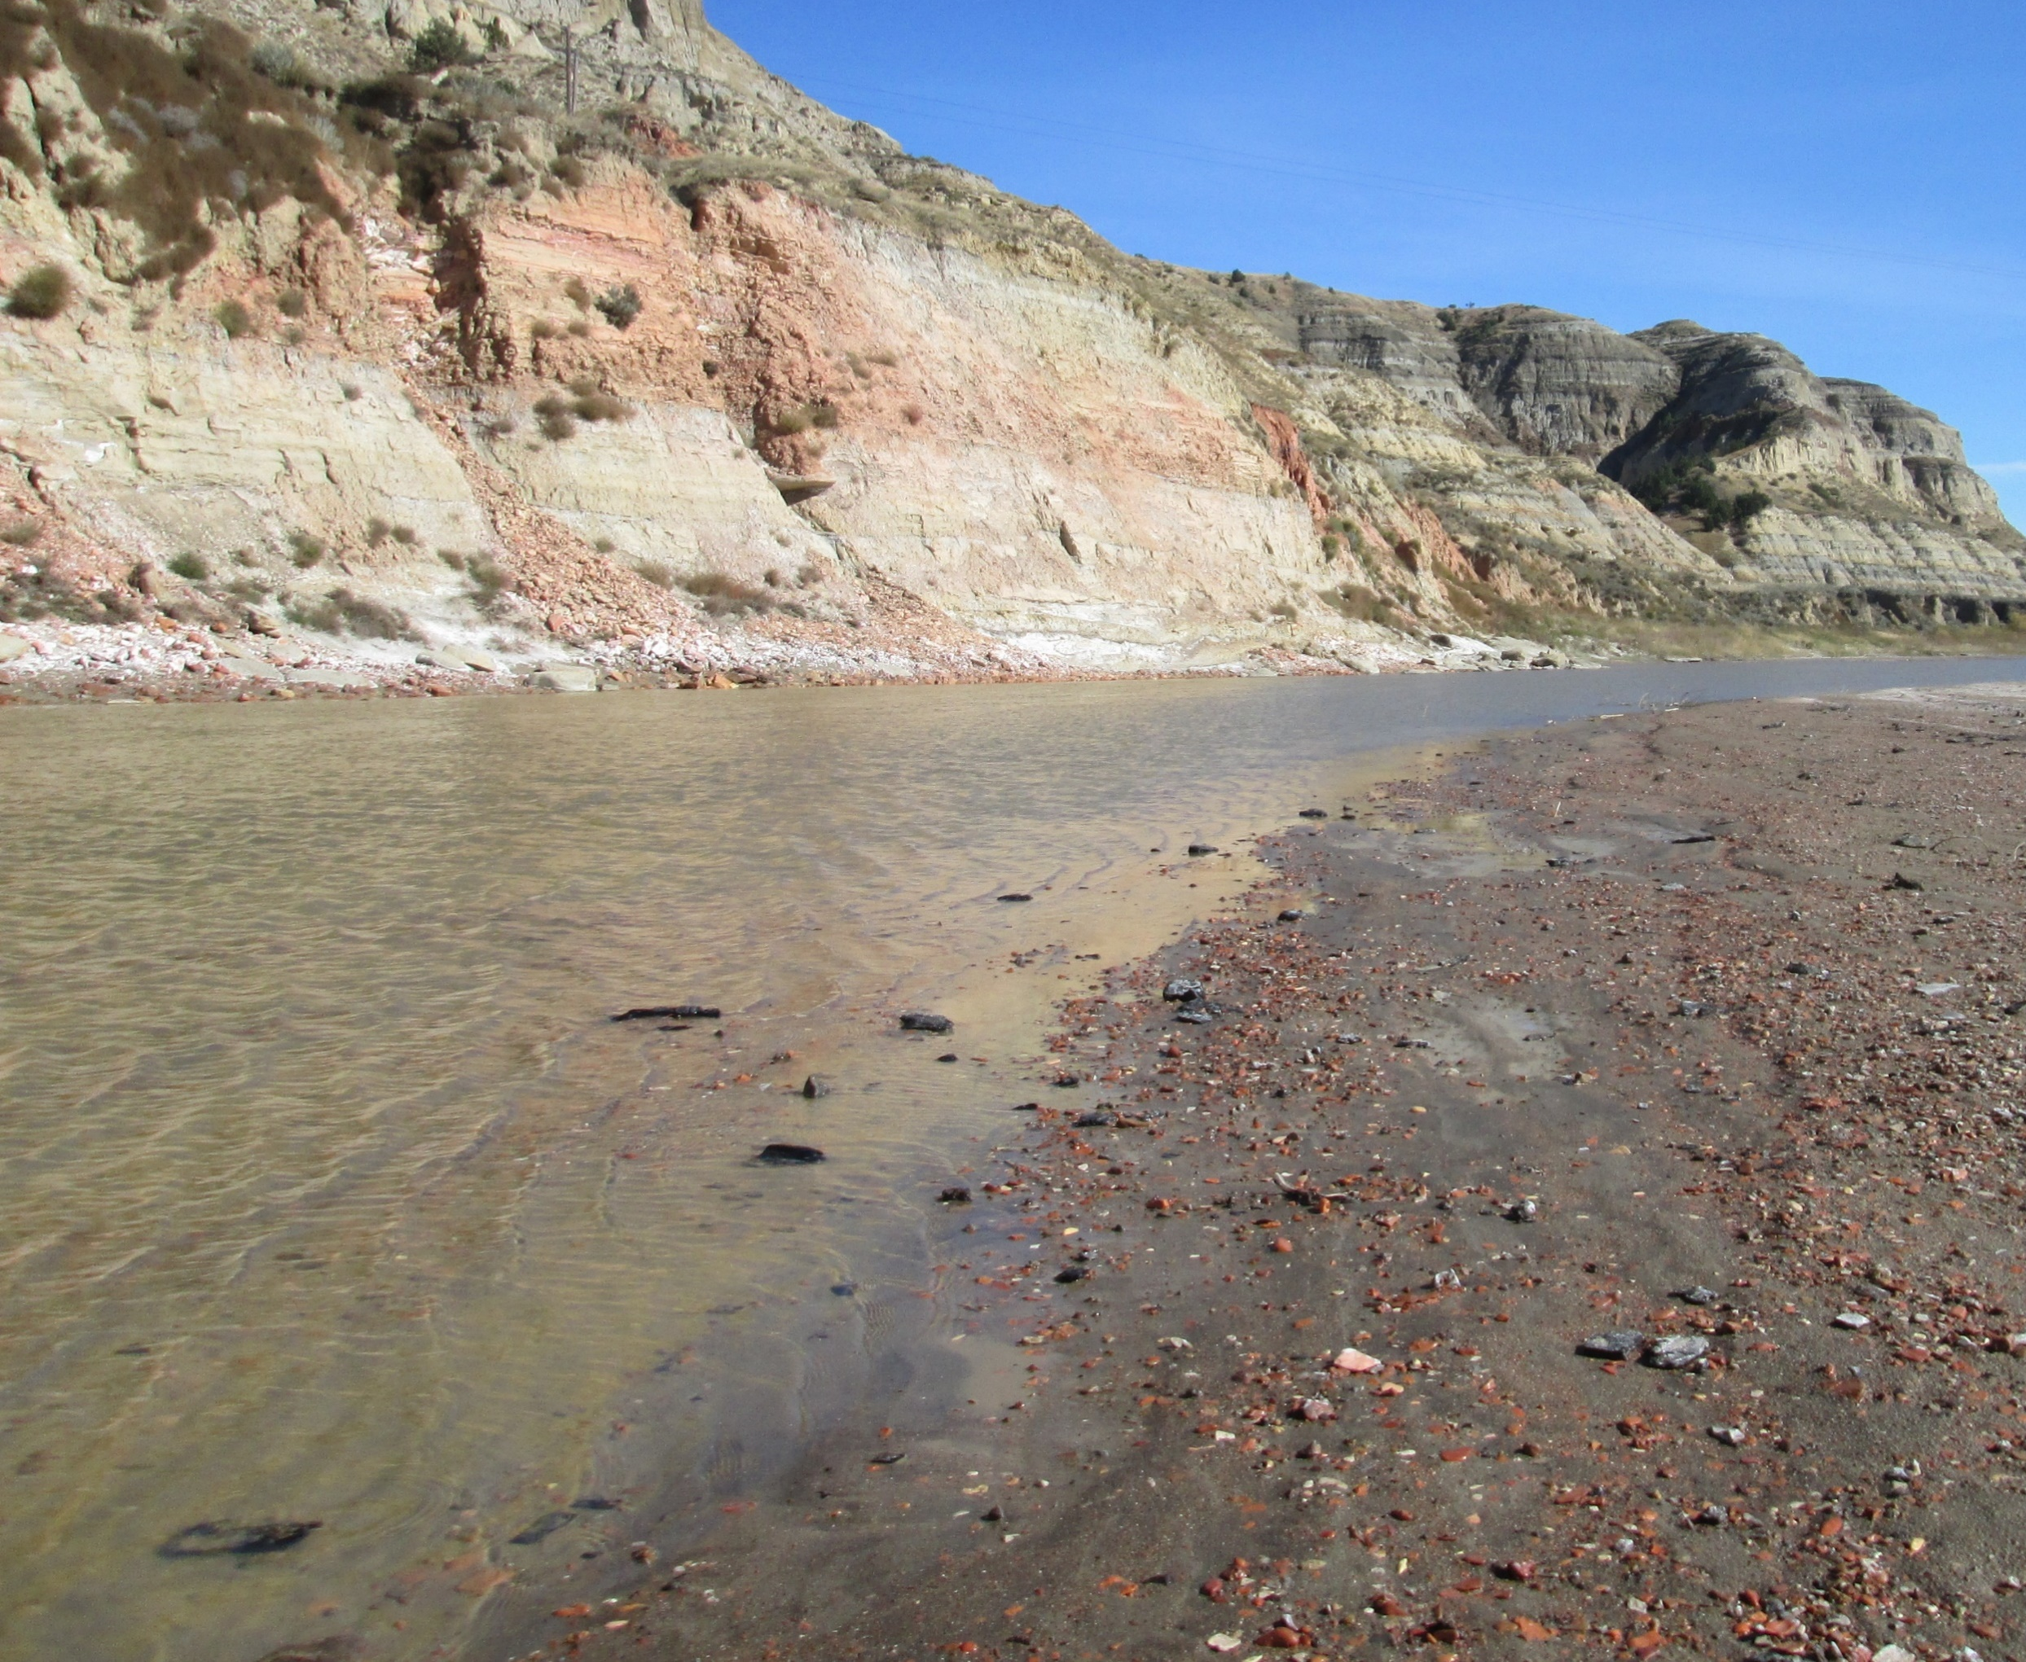
Longitudinal Profile
Slope
Boulders
0.02
0.001
0.00001
Modified from Anderson and Anderson (2010)
Dominant
Transport
Bedload
Bedload/Suspended
Photo Credit: Tim Kiser (Wikimedia Commons)
Bed
Materials
Suspension/Solution
Photo Credit: dontworry (Wikimedia Commons)
Solution/Suspension
Boulders
Gravel
Sand
Silt and Clay
>256 mm
2-256 mm
0.06-2 mm
< 0.06 mm

Slide 16
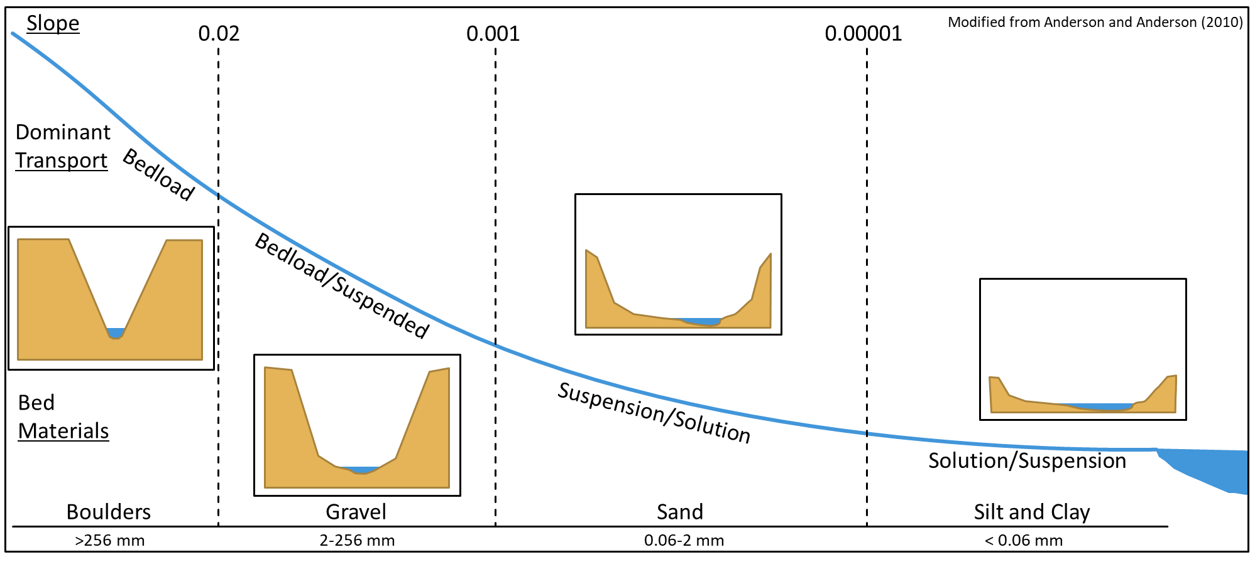
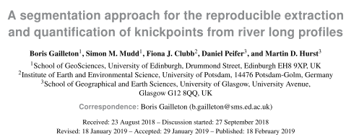
Recap
Long Profile and Slope can Inform on Dominant Processes
Slope Tends to Decrease Downstream
Channels Widen Downstream
Activity Shifts From Erosion to Deposition
Sediment Tends to Fine Downstream
Mode of Transport Shifts from Bedload to Suspended or Dissolved Load

